Slide 1
CIS9660: Data Mining for Business Analytics 4. Introduction to Logistic Regression Imp 3 4 5 6 8 9 10 13 14
(Gujarati, D.N., 2011. Econometrics by example. New York: Palgrave Macmillan. Chapter 8)

Slide 2
An Illustrative Example: To smoke or Not to smoke
There is a random sample of 1,196 US males. The variables are as follows:
Smoker = 1 for smokers and 0 for nonsmokers
Age = age in years
Education = number of years of schooling
Income = family income
Pcigs = price of cigarettes in individual states in 1979
Build a regression model to determine smoking behavior in relation to age, education, family income, and price of cigarettes.
Question: Is linear regression the most appropriate model here?
Dv is not continuous its 0 or 1 so we use logistic regression
Notes:
No.

Slide 3

What is logistic regression?
Although binary dependent variable models can be estimated by OLS, in which case they are known as linear probability models (LPM), OLS (a method used to estimate regression) is not the preferred method of estimation for such models because of two limitations：
The estimated probabilities from LPM do not necessarily lie in the bounds of 0 and 1
LPM assumes that the probability of a positive response increases linearly with the level of the explanatory variable, which is counterintuitive.
To address this problem, we introduce Logistic regression which is a nonlinear regression model specifically designed for binary dependent variables.

Slide 4
What is logistic regression?
Logistic Regression
Basic form (this is our focus in this course):
Binary logistic regression: the dependent variable is a dummy variable: coded 0 or 1
E.g., 1 (leave) or 0 (not leave), 1 (die) or 0 (not die), 1 (pass) or 0 (not pass)
Extended forms:
Multinomial logistic regression: the dependent variable has categorical outputs
E.g., determining the probability an image contains a car, a motorcycle, or a bicycle, etc...
Ordinal logistic regression: the dependent variable has ordered categorical outputs
E.g., determining the probability a student gets an A, B, C or a lower grade in one course etc...

Slide 5
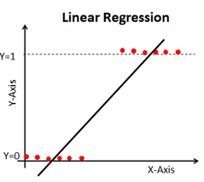
Why logistic regression?
The major problems with using linear model to estimate class probability:
Violate some assumptions of linear regression (e.g., linear correlation)
Predicted value of y ranges from –∞ to ∞, but a probability should range from zero to one.
>1
<0

Slide 6
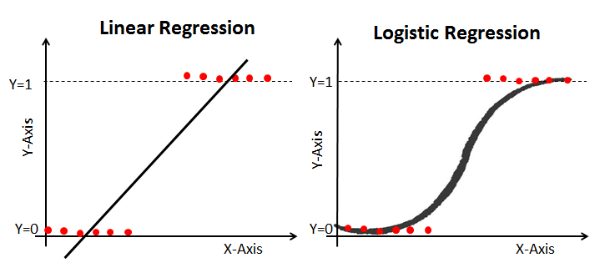
Why logistic regression?
The benefit of using logistic models to estimate class probability:
Based on quite different assumptions from those of linear regression
Logistic function is mathematically correct. Linear regression can only give an approximation of the truth
Predicted value of y ranges from zero to one

Slide 7

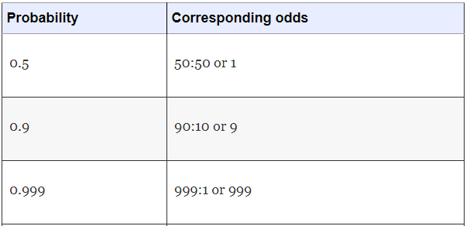
Transformation: Logistic to Linear
To better understand logistic regression, we will discuss another representation of the likelihood of an event: Odds ratio
Odds=
The odds of an event is the ratio of the probability of the event occurring to the probability of the event not occurring

Slide 8

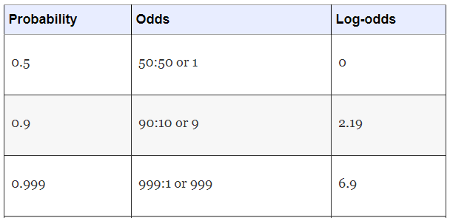
Transformation: Logistic to Linear
Then we take the logarithm of the odds (called the “log-odds”)
Log-odds=
For any number in the range 0 to ∞ its log will be between –∞ to ∞

Slide 9


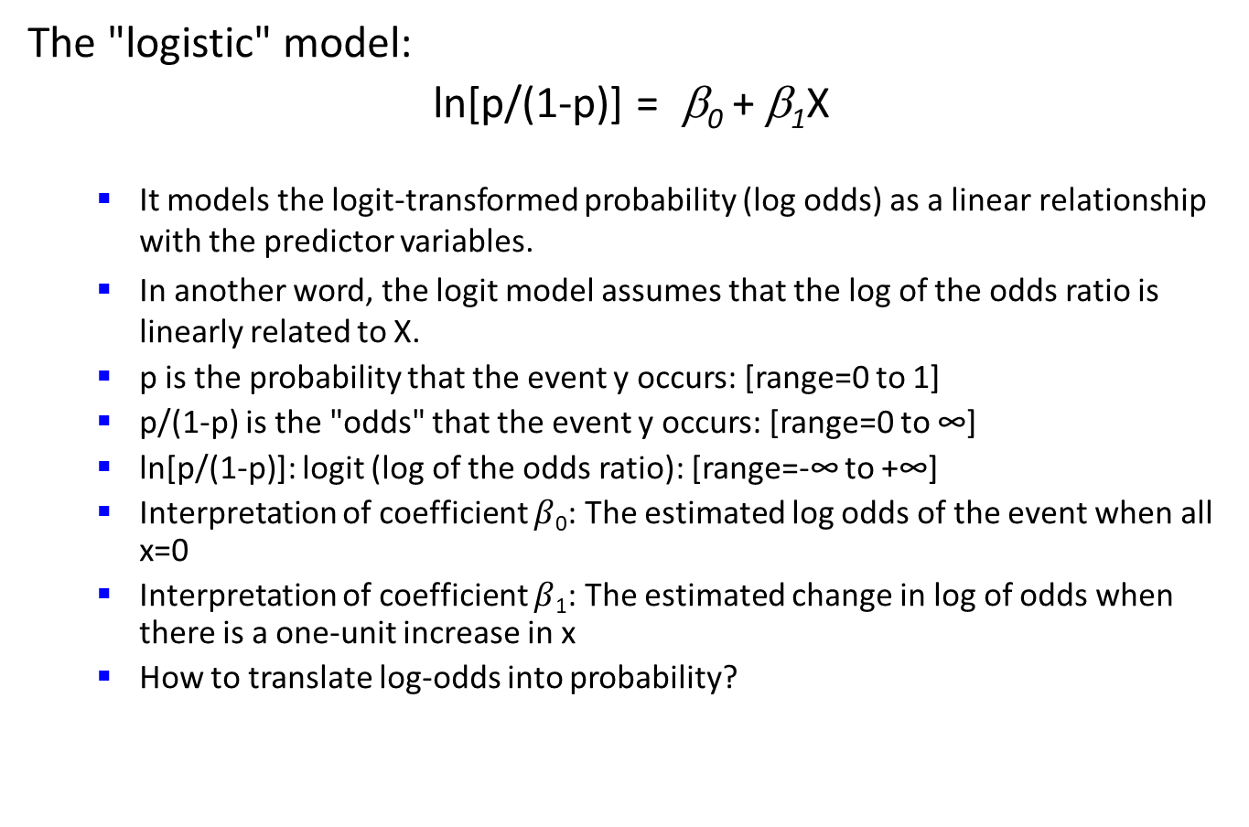
Transformation: Logistic to Linear
The "logistic" model:
ln[p/(1-p)] = β₀ + β₁X
It models the logit-transformed probability (log odds) as a linear relationship with the predictor variables.
In another word, the logit model assumes that the log of the odds ratio is linearly related to X.
p is the probability that the event y occurs: [range=0 to 1]
p/(1-p) is the "odds" that the event y occurs: [range=0 to ∞]
ln[p/(1-p)]: logit (log of the odds ratio): [range=-∞ to +∞]
Interpretation of coefficient $β$₀: The estimated log odds of the event when all x=0
Interpretation of coefficient $β$₁: The estimated change in log of odds when there is a one-unit increase in x
How to translate log-odds into probability?

Slide 10
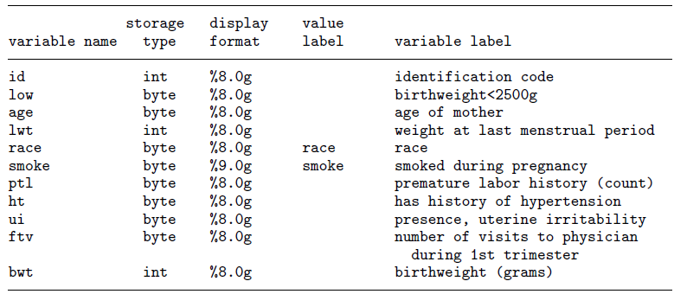
Parameter Estimation in R
Consider the following dataset from a study of risk factors associated with low birthweight described in Hosmer, Lemeshow, and Sturdivant (2013, 24).

Slide 11
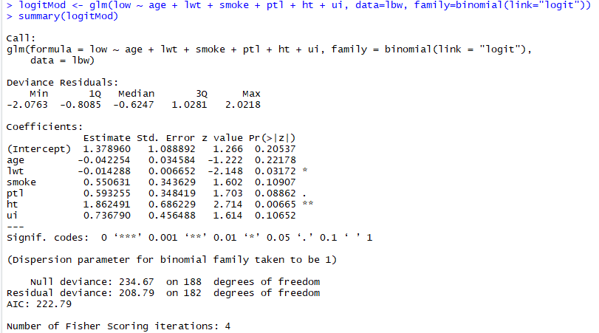


Parameter Estimation in R
Dependent variable
Independent variables
Name of the data file
Logistic regression model
$$β0$$
$$β1$$
P value for significance test
How to interpret the parameters?
-Holding other variables constant, if lwt increases by one unit, the average log odds in favor of having low birthweight goes down by 0.014.
Notes:
Why average? because the change in probability of low birthweight if lwt changes by a unit depends not only on the coefficient of the lwt variable but also on values of all the explanatory variables.

Slide 12
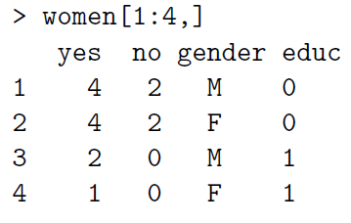
An Example
Attitude towards women's roles
In 1979, women's and men's attitudes toward women's familial roles were examined using the questionnaire \Do women belong in the home?" in a cross-sectional survey of US adults, cross-classified by respondent's gender and their formal education measured in years. What model should we use to examine the determinants of people’s attitudes toward women's familial roles?
Key variables:
yes: the number of people who responds yes
no: the number of people who responds no
gender: the gender, treated as categorical variable
educ: years of education, treated as continuous
A sample of the data set:
Notes:
Ln(p/(1-p))=B₀+B1Male+B₂Educ

Slide 13
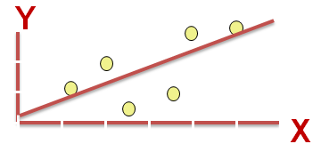
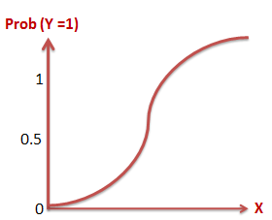
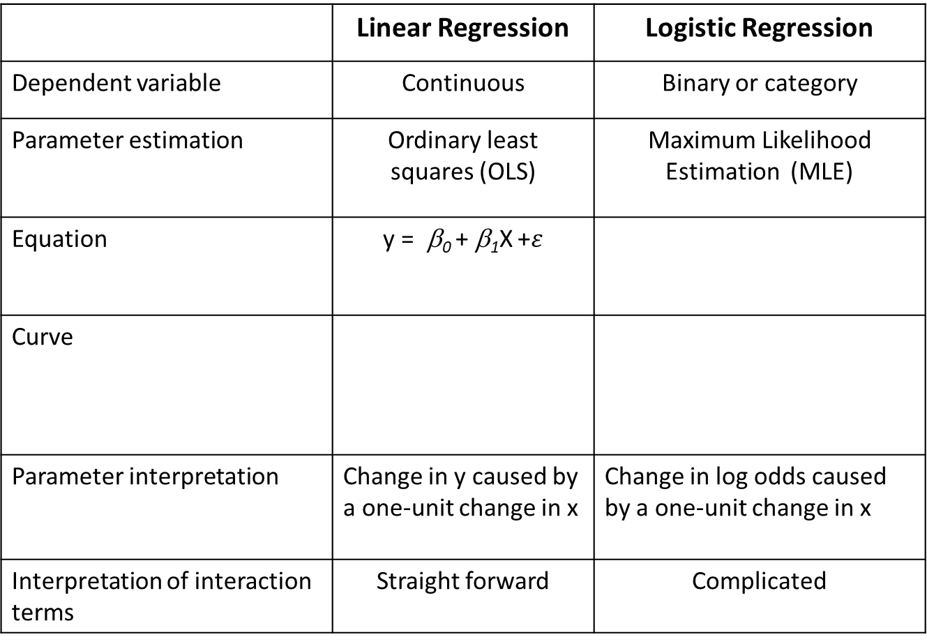
Logistic Regression versus Linear Regression
 | Linear Regression | Logistic Regression
Dependent variable | Continuous | Binary or category
Parameter estimation | Ordinary least squares (OLS) | Maximum Likelihood Estimation (MLE)
Equation | y = β₀ + β₁X +$ε$
Curve
Parameter interpretation | Change in y caused by a one-unit change in x | Change in log odds caused by a one-unit change in x
Interpretation of interaction terms | Straight forward | Complicated

Slide 14


Logistic Regression versus Linear Regression
Examine whether online reviews influence product sales
Examine factors associated with the valance of ratings
Examine risk factors associated with low ratings (<3stars)
Examine how monetary incentives influence review numbers
Build an algorithm to improve online ratings of a restaurant

Slide 15
Summary
Why logistic regression?
What is odds ratio?
What is the basic form of logistic regression?
How to estimate the parameters of logistic regression?
How to interpret the parameters of logistic regression?
How to choose between logistic and linear regression?

